Slide 1
The Transport Layer
Chapter 6

Slide 2
Transport Service
Upper Layer Services
Transport Service Primitives
Berkeley Sockets
Example of Socket Programming:
Internet File Server

Slide 3
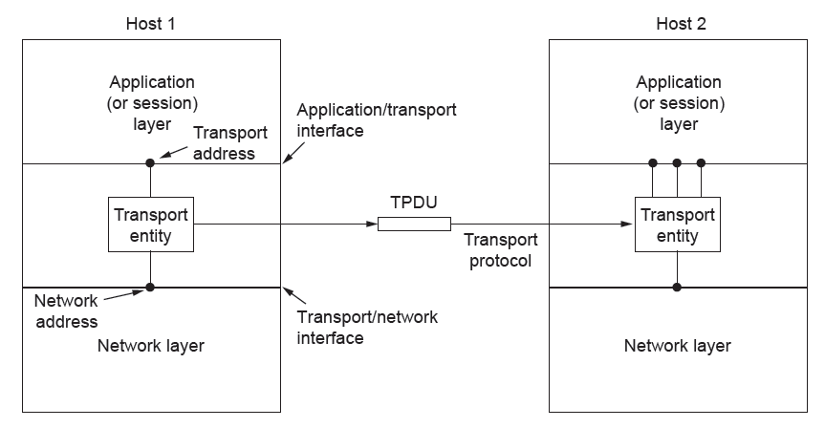
Services Provided to the Upper Layers
The network, transport, and application layers
Establishment, data transfer and release/ Make it more reliable than the underlying layer

Slide 4
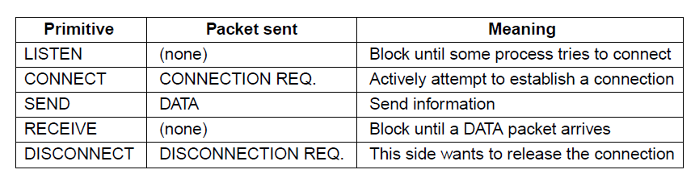
Transport Service Primitives (1)
The primitives for a simple transport service

Slide 5
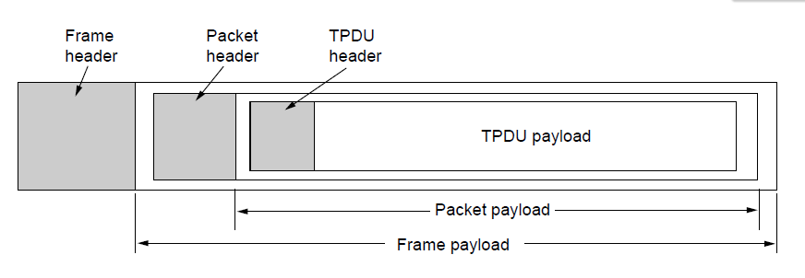
Transport Service Primitives (2)
Nesting of TPDU (Transport Protocol Data Unit) s, packets, and frames.

Slide 6
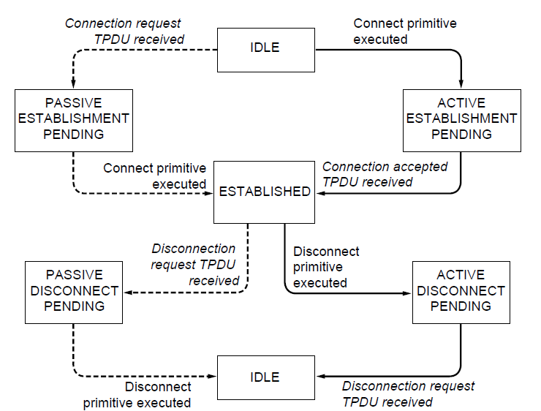
Berkeley Sockets (1)
A state diagram for a simple connection management scheme. Transitions labeled in italics are caused by packet arrivals. The solid lines show the client’s state sequence. The dashed lines show the server’s state sequence.

Slide 7
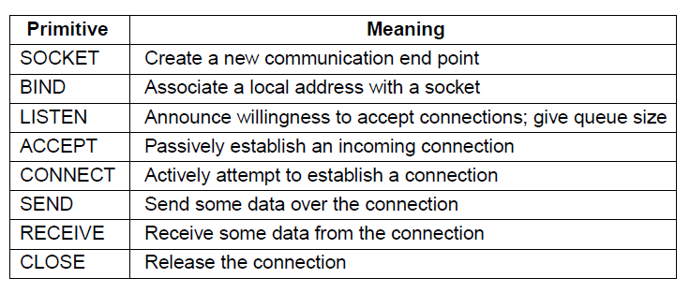
Berkeley Sockets (2)
The socket primitives for TCP

Slide 8
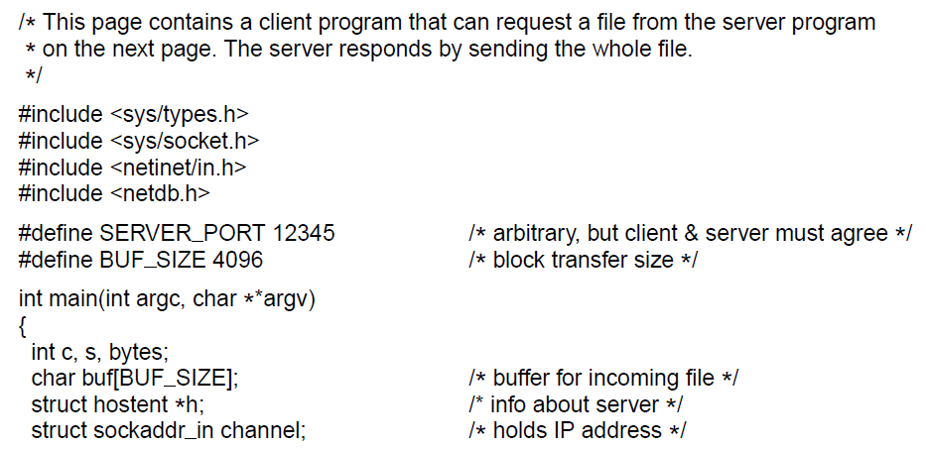
Example of Socket Programming:
An Internet File Server (1)
. . .
Client code using sockets

Slide 9
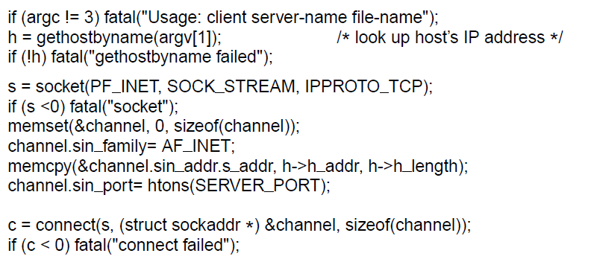
Example of Socket Programming:
An Internet File Server (2)
. . .
. . .
Client code using sockets

Slide 10
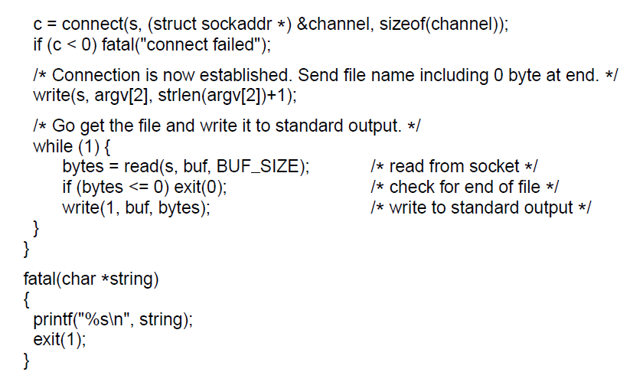
Example of Socket Programming:
An Internet File Server (3)
. . .
Client code using sockets

Slide 11
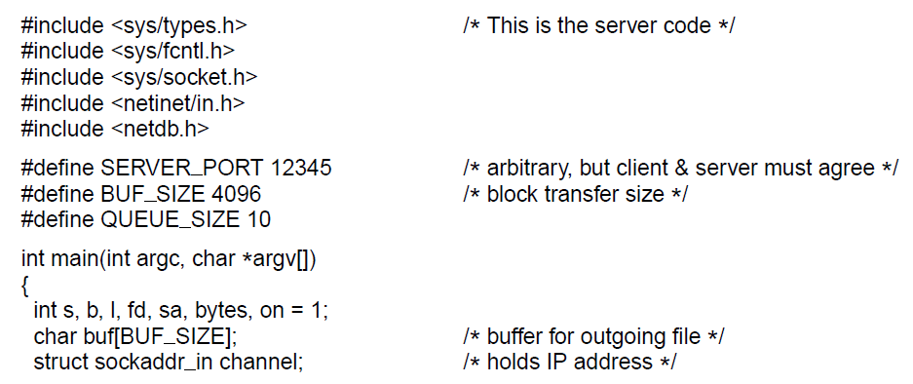
Example of Socket Programming:
An Internet File Server (4)
. . .
Server code

Slide 12
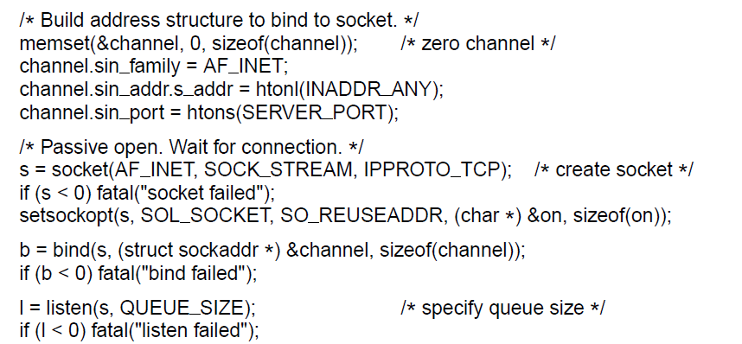
Example of Socket Programming:
An Internet File Server (5)
. . .
. . .
Server code

Slide 13
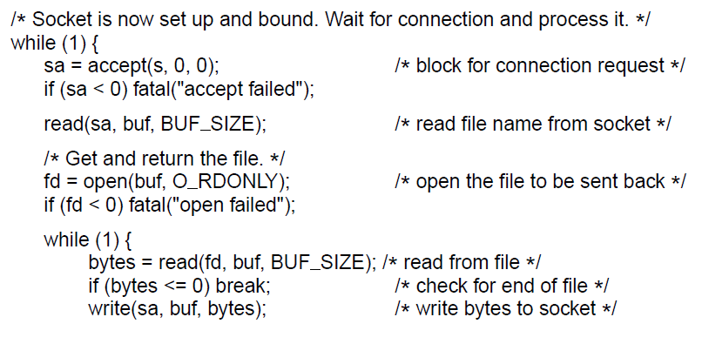
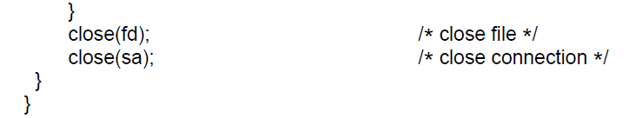
Example of Socket Programming:
An Internet File Server (6)
. . .
Server code

Slide 14
Elements of Transport Protocols (1)
Addressing
Connection establishment
Connection release
Error control and flow control
Multiplexing
Crash recovery

Slide 15
Similarity between data link and transport layer
Connection establishment
Connection release
Error control and flow control

Slide 16
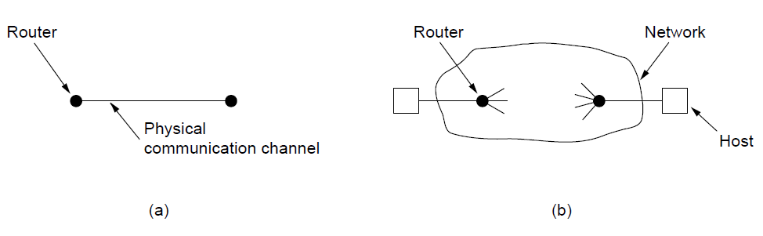
Elements of Transport Protocols (2)
Environment of the data link layer.
Environment of the transport layer.

Slide 17
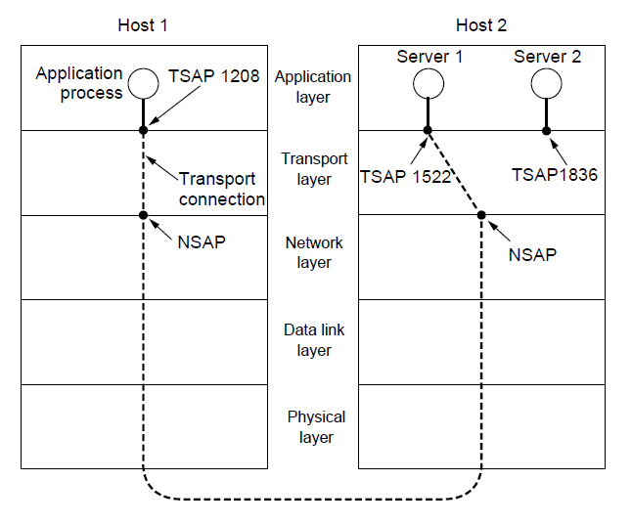
Addressing (1)
TSAPs, NSAPs, and transport connections

Slide 18
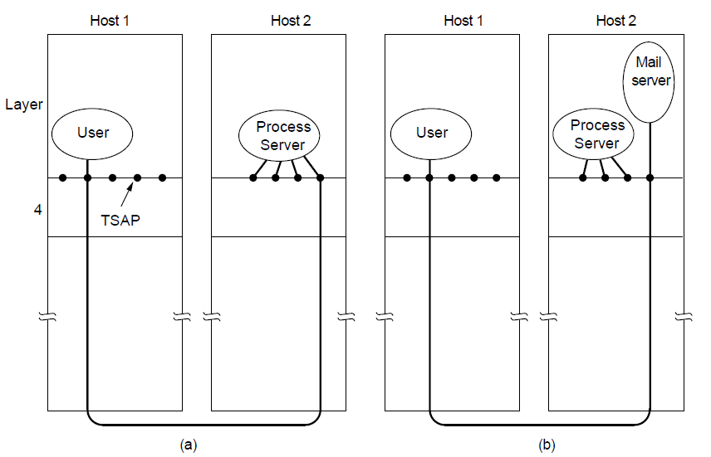
Addressing (2)
How a user process in host 1 establishes a connection
with a mail server in host 2 via a process server.

Slide 19
Connection Establishment (1)
Techniques for restricting packet lifetime
Throwaway transport addresses
Each connection a identifier <Peer transport entity, connection entity>

Slide 20
Connection Establishment (2)
Maintain history problem if crashed
Restricted network design.
Putting a hop counter in each packet.
Timestamping each packet.
Also acknowledgement needs to be erased with time T

Slide 21
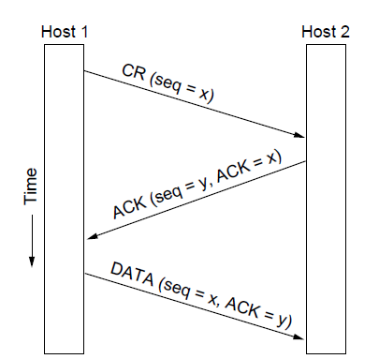
Connection Establishment (3)
Three protocol scenarios for establishing a connection using a
three-way handshake. CR denotes CONNECTION REQUEST. Normal operation.

Slide 22
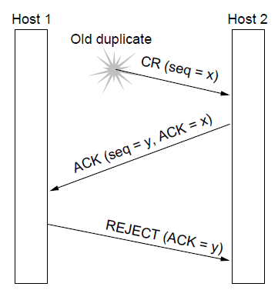
Connection Establishment (4)
Three protocol scenarios for establishing a connection using a
three-way handshake. CR denotes CONNECTION REQUEST. Old duplicate CONNECTION REQUEST appearing out of nowhere.

Slide 23
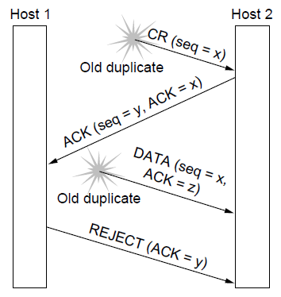
Connection Establishment (5)
Three protocol scenarios for establishing a connection using a
three-way handshake. CR denotes CONNECTION REQUEST. Duplicate CONNECTION REQUEST and duplicate ACK

Slide 24
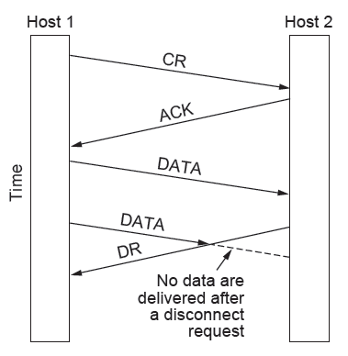
Connection Release (1)
Abrupt disconnection with loss of data – one way release or two way release

Slide 25
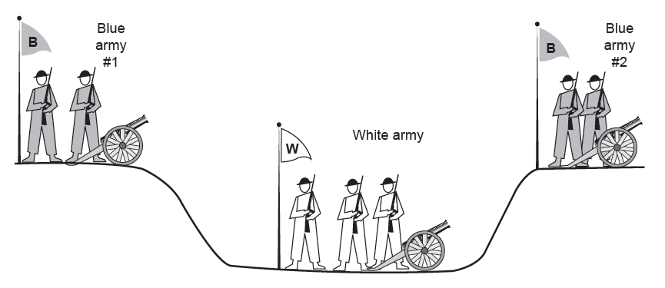
Connection Release (2)
The two-army problem
Synchronize which will go on infinitely

Slide 26
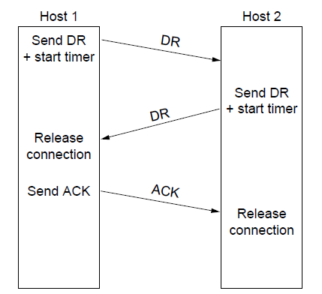
Connection Release (3)
Four protocol scenarios for releasing a connection.
(a) Normal case of three-way handshake

Slide 27
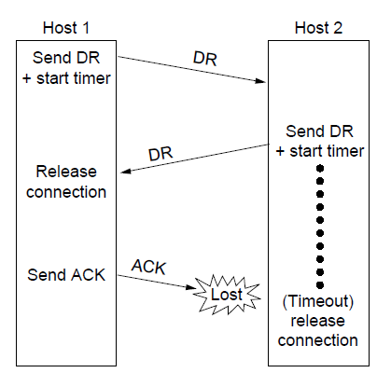
Connection Release (4)
Four protocol scenarios for releasing a connection.
(b) Final ACK lost.

Slide 28
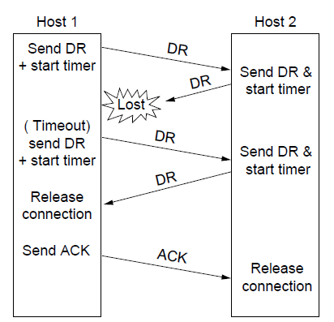
Connection Release (5)
Four protocol scenarios for releasing a connection.
(c) Response lost

Slide 29
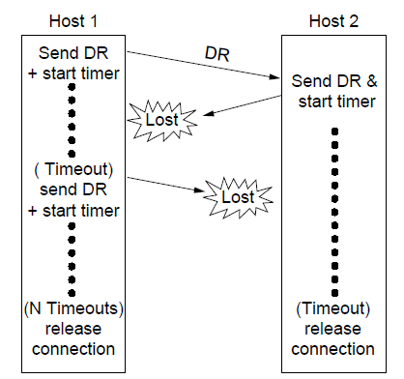
Connection Release (6)
Four protocol scenarios for releasing a connection.
(d) Response lost and subsequent DRs lost.

Slide 30
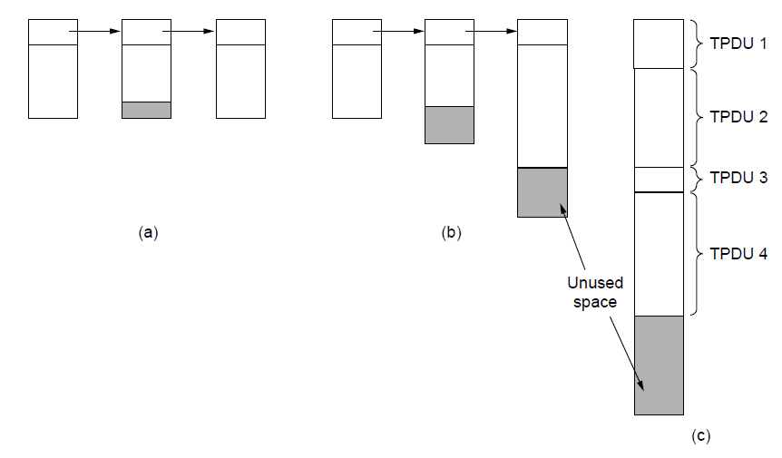
Error Control and Flow Control (1)
(a) Chained fixed-size buffers. (b) Chained variable-sized buffers. (c) One large circular buffer per connection.

Slide 31
For low-bandwidth bursty traffic, it is better not allot buffer but dynamically allot buffer
Decouple sliding window protoco;

Slide 32
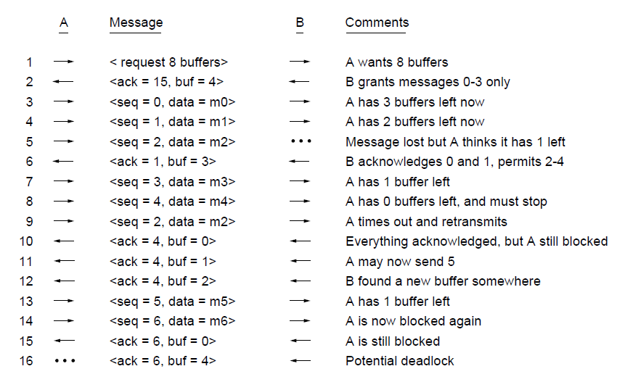
Error Control and Flow Control (2)
Dynamic buffer allocation. The arrows show the direction of transmission. An ellipsis (...) indicates a lost TPDU

Slide 33
Infinite size buffer – k disjoint paths, x packets/sec
If the network can handle c TPDU/sec, cycle time – r then total = cr

Slide 34
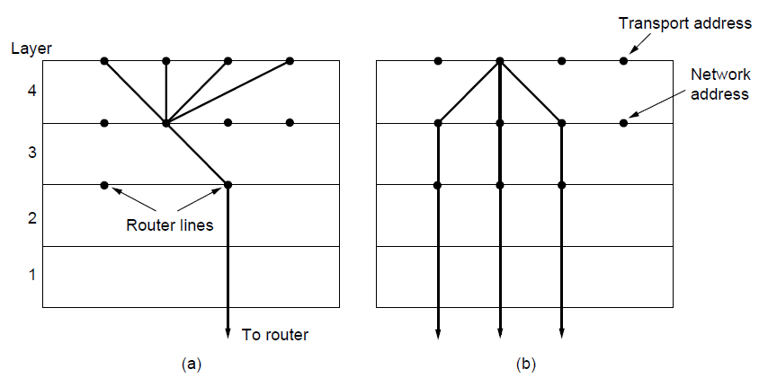
Multiplexing
(a) Multiplexing. (b) Inverse multiplexing.

Slide 35
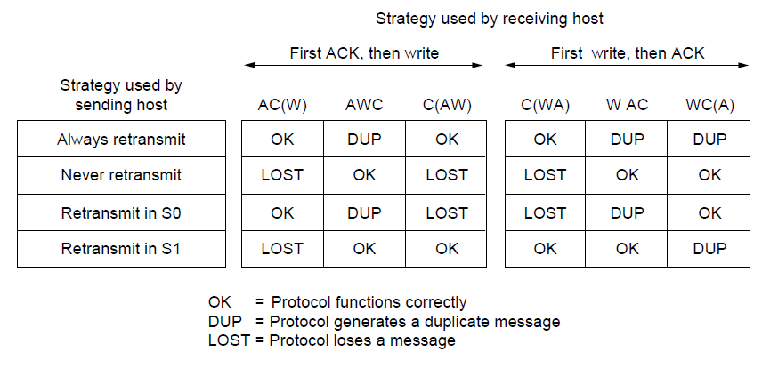
Crash Recovery
Different combinations of client and server strategy

Slide 36
The Internet Transport Protocols: TCP (1)
Introduction to TCP
The TCP service model
The TCP protocol
The TCP segment header
TCP connection establishment
TCP connection release

Slide 37
The Internet Transport Protocols: TCP (2)
TCP connection management modeling
TCP sliding window
TCP timer management
TCP congestion control
TCP futures

Slide 38
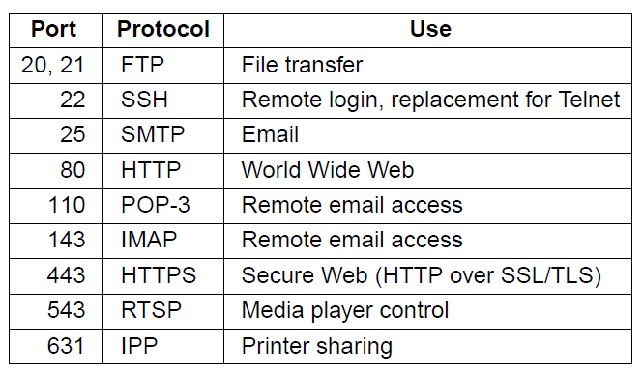
The TCP Service Model (1)
Some assigned ports
Internet Daemon (inetd) attach itself to multiple ports and wait for the first connection request, then fork to that service

Slide 39
All TCP connections are full duplex and point-to-point
Each connection has exactly two ends
TCP doesn’t support multicasting or broadcasting.

Slide 40
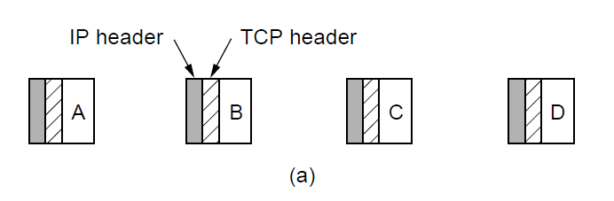
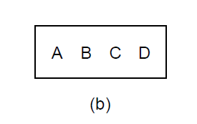
The TCP Service Model (2)
The TCP is byte-stream and not a message-stream, so messages are not differentiated.
Four 512-byte segments sent as separate IP diagrams
The 2048 bytes of data delivered to the application in a single READ call

Slide 41
The TCP Service Model (2)
To force data out -- PUSH flag
Too many PUSH-es then all PUSH are collected together and sent.
URGENT – on pushing Ctrl-C to break-off remote computation, the sending application puts some control flag

Slide 42
TCP Header
TCP segment – 20 byte IP header, 20 –byte TCP header, total 65,535 = 64 KB

Slide 43
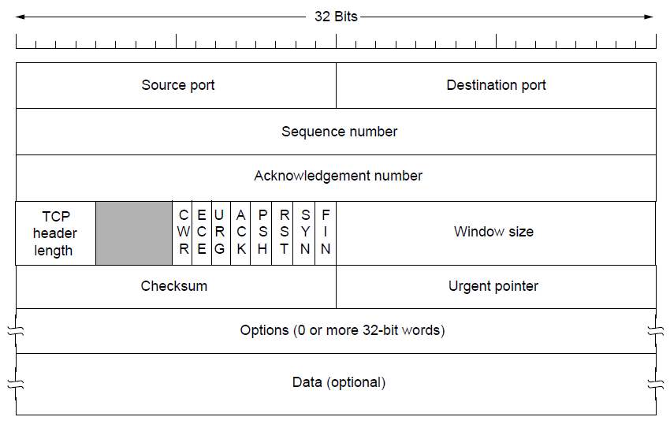
The TCP Segment Header
Ack no = one more – what is next expected
TCP Header – how many optional field
CWR/ECE – Congestion controlling bits (ECE – Echo, CWR – Congestion window reduced)
URG – Urgent, (URGENT POINTER – OFFSET) ACK – Acknowledgement, PSH – Pushed RST – reset, SYN = 1 (CONNECTION REQUEST, CONNECTION ACEEPTED), ACK =0 (REQUEST) ACK = 1(ACCEPT)
WINDOW SIZE = HOW MANY BUFFERS MAY BE GRANTED, CAN BE ZERO

Slide 44
The TCP Segment Header
CHECK SUM – IP ADDR + TCP HEADER + DATA,
ADD ALL THE 16 BITS WORD IN ONES COMPLEMENT AND THEN TAKE ONE’ COMPLEMENT OF THE SUM
ON ADD WITH CHECKSUM – SUMMATION WOULD BE ZERO
CROSS LAYER

Slide 45
The TCP Segment Header
INSTEAD OF GO-BACK-N, HAVE NAKS

Slide 46
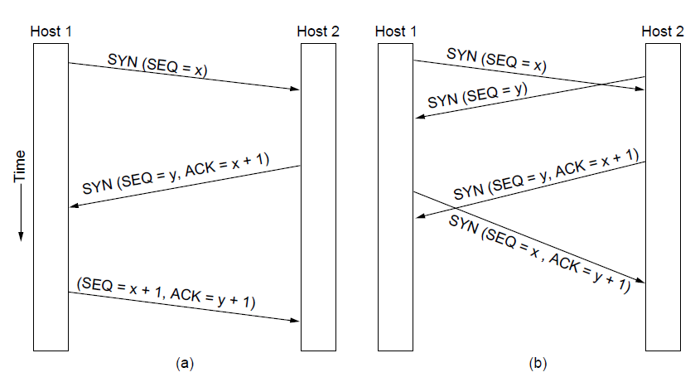
TCP Connection Establishment
TCP connection establishment in the normal case.
Simultaneous connection establishment on both sides.

Slide 47
TCP Connection Release
Either party send with the FIN bit set
When the FIN is acknowledged, that direction is shut down for new data
Full closing (TWO FIN and TWO ACK)

Slide 48
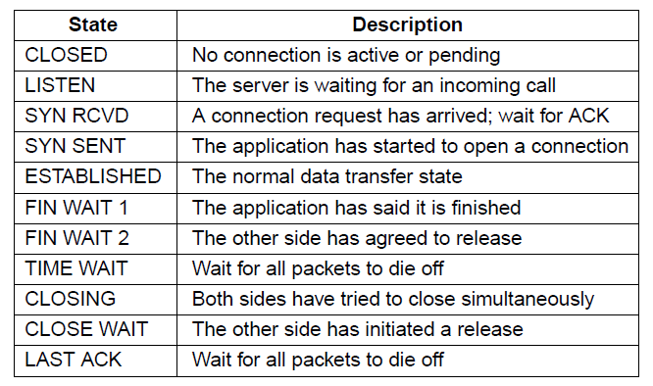
TCP Connection Management Modeling (1)
The states used in the TCP connection
management finite state machine.

Slide 49
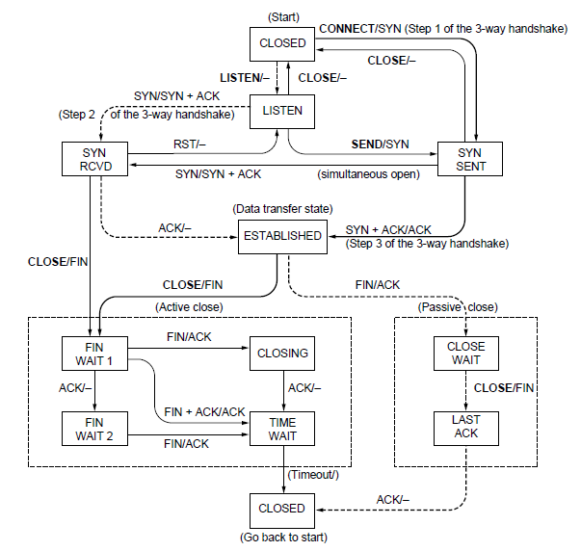
TCP Connection Management Modeling (2)
TCP connection management finite state machine.
The heavy solid line is the normal path for a client. The heavy dashed line is the normal path for a server. The light lines are unusual events. Each transition is labeled by the event causing it and the action resulting from it, separated by a slash.

Slide 50
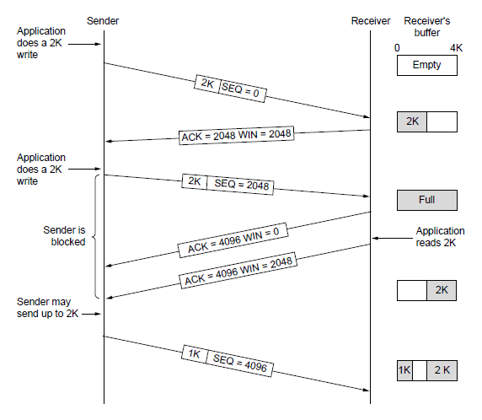
TCP Sliding Window (1)
Window management in TCP
When send – with ) window size – a). Urgent bytes and b). 1- byte to make the receiver to reannounce the next byte expected

Slide 51
Nagle’s Algorithm
Interactive Editor --- Sending 1-byte would involve 162 bytes (40 to send, 40 to ACK, 41 to update, 40 to ack)
Nagle’s Algorithm – When data comes into the sender one byte at a time, just send the first byte and buffer the rest until the outstanding byte is acknowledged

Slide 52
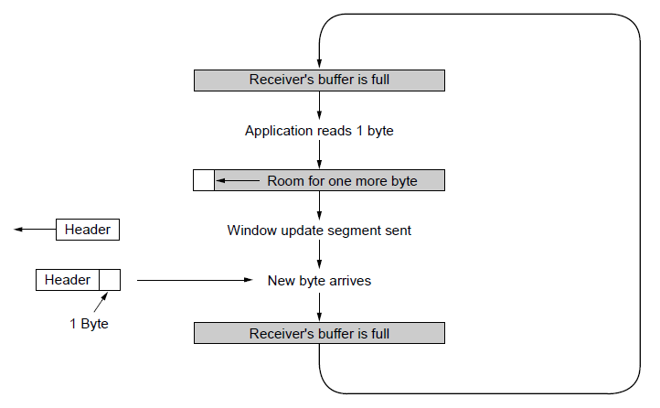
TCP Sliding Window (2)
Silly window syndrome … Clark’s solution – prevent receiver from sending a window update for 1 byte.
Specifically the receiver should not send a window update until it get the maximum segement advertised free

Slide 53
Receiver – Block READ from the application until a large chunk of data arrives
Out of order – 0, 1,2,4,5,6,7

Slide 54
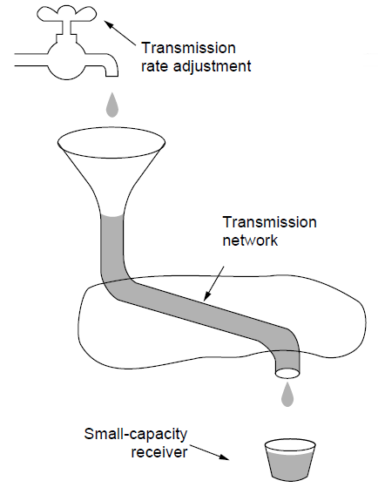
TCP Congestion Control -- Regulating the Sending Rate (1)
A fast network feeding a low-capacity receiver

Slide 55
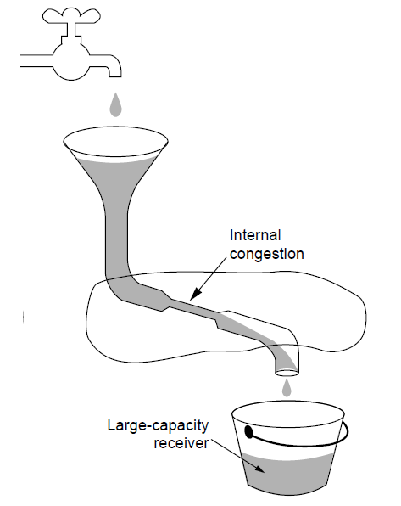
Regulating the Sending Rate (2)
A slow network feeding a high-capacity receiver

Slide 56
TCP Congestion Control
Two windows – the window a receiver window grants
Congestion window
Slow start – 1024 byte - move exponentially – SLOW START
Set threshold – grow linearly after that

Slide 57
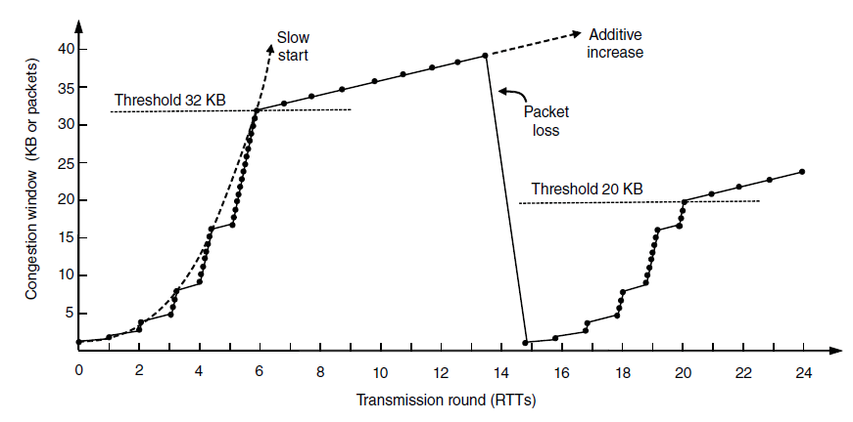
TCP Congestion Control (3)
Slow start followed by additive increase in TCP Tahoe.

Slide 58
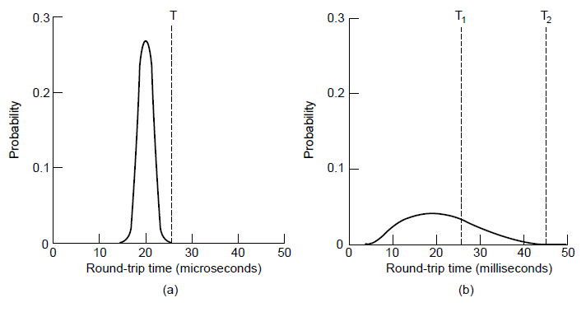
TCP Timer Management
(a). Retransmission timer
Probability density of acknowledgment arrival times in data link layer. (b) … for TCP

Slide 59
Retransmission Timer
RTT = \alpha RTT + (1- \alpha) M
Time-out = \beta . RTT
D = \alpha . D + (1 - \alpha) |RTT – M|
Timeout = RTT + 4 x D

Slide 60
Retransmission Timer
Karn’s algorithm – In dynamic estimation of RTT when a segment times out and is resend.
It is not clear whether the acknowledgement is from the original or resend.
SO don’t include resend packets RTT into calculation.
Each time failure double Time-out time

Slide 61
Persistence Timer
When Persistence timer goes off the transmitter pings the receiver whether buffer space is available
Keepalive TImer
If idle → checks whether the connection is active and then if not closes connection
CONTROVERSIAL – It may stop healthy connection due to transient network partitioning

Slide 62
The Internet Transport Protocols: UDP
Introduction to UDP
Remote Procedure Call
Real-Time Transport

Slide 63
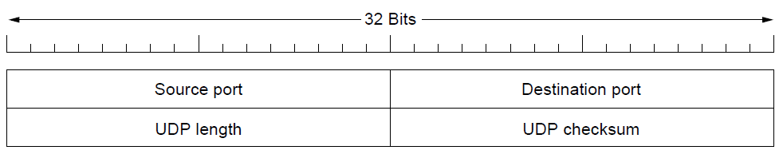
Introduction to UDP (1)
The UDP header.
Checksum not used (digitized speech)
Does not flow-control, error control or timing
Does Multiplexing
UDP useful – client-server situations, client sends a short request to the server and expects a short reply back. If time-out retransmit rather than establish connection
Use-case – host name to a DNS server

Slide 64
Remote Procedure Call
get_ip_address(host_name)

Slide 65
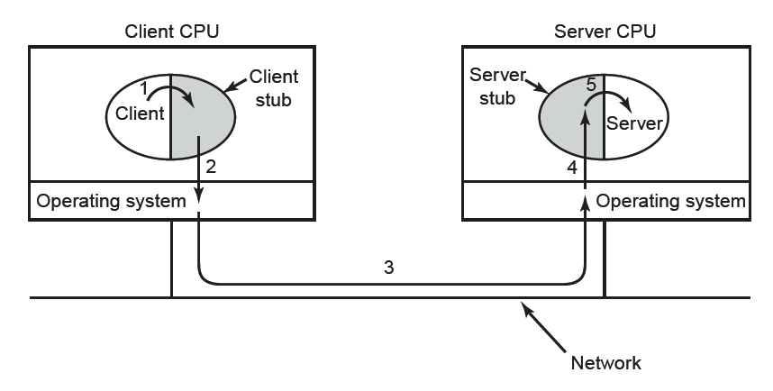
Remote Procedure Call
Steps in making a remote procedure call. The stubs are shaded.
Packing the parameters is called marshalling

Slide 66
Remote Procedure Call
get_ip_address(host_name)
Pointer, global variable

Slide 67
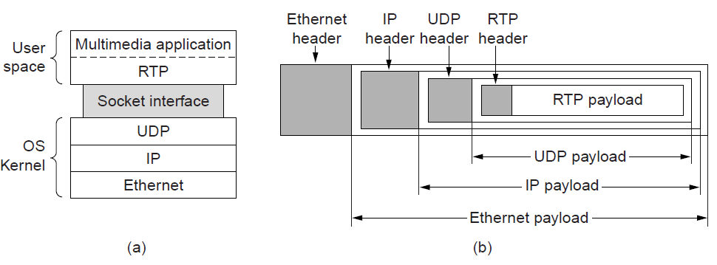
Real-Time Transport (1)
(a) The position of RTP in the protocol stack. (b) Packet nesting.

Slide 68
Real-Time Transport (1)
It is difficult to say which layer RTP is in
It is generic and application independent
Best Description - transport protocol implemented in the application layer
Basic Function of RTP – multiplex several real-time data streams onto a single stream of UDP packets.
Each packet is given a number one higher than its predecessor.
Allows the destination to determine whether any packets are missing
Then interpolate

Slide 69
Real-Time Transport (1)
Timestamp
Relative values can be obtained
Allow multiple streams (audio/video) to combine together

Slide 70
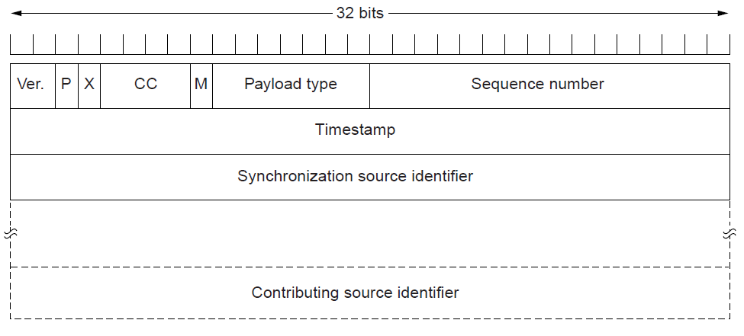
Real-Time Transport (2)
The RTP header

Slide 71
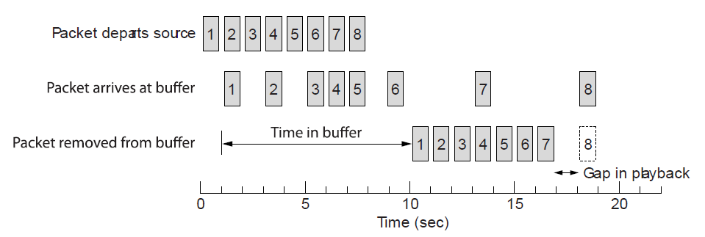
Real-Time Transport (3)
Smoothing the output stream by buffering packets

Slide 72
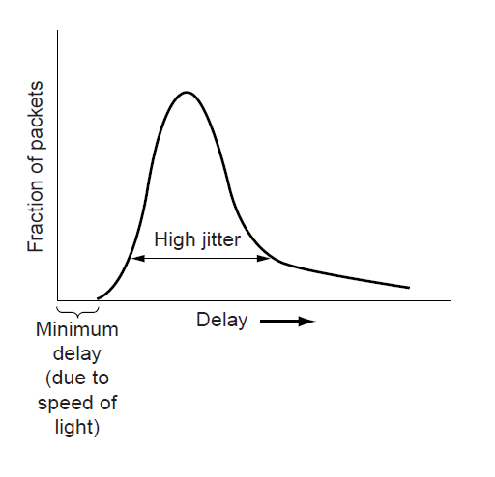
Real-Time Transport (3)
High jitter

Slide 73
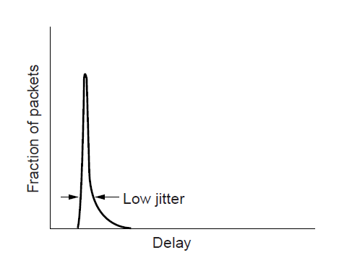
Real-Time Transport (4)
Low jitter

Slide 74
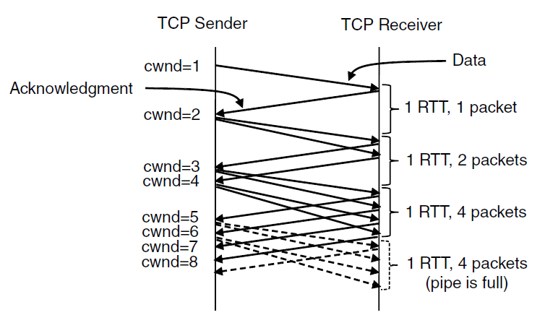
TCP Congestion Control (1)
Slow start from an initial congestion window of 1 segment

Slide 75
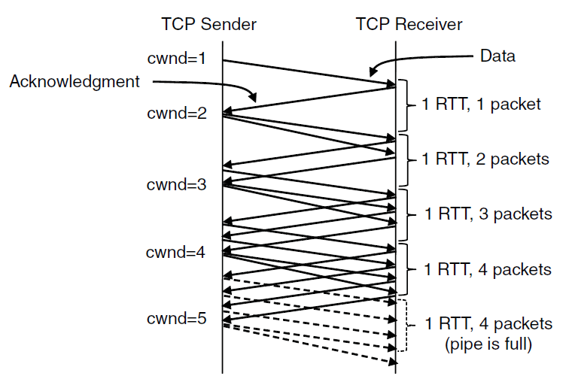
TCP Congestion Control (2)
Additive increase from an initial congestion
window of 1 segment.

Slide 76

TCP Congestion Control (4)
Fast recovery and the sawtooth pattern of TCP Reno.

Slide 77
Performance Issues
Performance problems in computer networks
Network performance measurement
System design for better performance
Fast TPDU processing
Protocols for high-speed networks

Slide 78

Performance Problems in Computer Networks
The state of transmitting one megabit from San Diego to Boston. (a) At t = 0. (b) After 500 μ sec.
(c) After 20 msec. (d) After 40 msec.

Slide 79
Network Performance Measurement (1)
Steps to performance improvement
Measure relevant network parameters, performance.
Try to understand what is going on.
Change one parameter.

Slide 80
Network Performance Measurement (2)
Issues in measuring performance
Sufficient sample size
Representative samples
Clock accuracy
Measuring typical representative load
Beware of caching
Understand what you are measuring
Extrapolate with care

Slide 81

Network Performance Measurement (3)
Response as a function of load.

Slide 82
System Design for Better Performance (1)
Rules of thumb
CPU speed more important than network speed
Reduce packet count to reduce software overhead
Minimize data touching
Minimize context switches
Minimize copying
You can buy more bandwidth but not lower delay
Avoiding congestion is better than recovering from it
Avoid timeouts

Slide 83

System Design for Better Performance (2)
Four context switches to handle one packet
with a user-space network manager.

Slide 84

Fast TPDU Processing (1)
The fast path from sender to receiver is shown with a heavy line. The processing steps on this path are shaded.

Slide 85

Fast TPDU Processing (2)
(a) TCP header. (b) IP header. In both cases, the shaded fields are taken from the prototype without change.

Slide 86

Protocols for High-Speed Networks (1)
A timing wheel

Slide 87

Protocols for High-Speed Networks (2)
Time to transfer and acknowledge a
1-megabit file over a 4000-km line

Slide 88
Delay Tolerant Networking
DTN Architecture
The Bundle Protocol

Slide 89

DTN Architecture (1)
Delay-tolerant networking architecture

Slide 90

DTN Architecture (2)
Use of a DTN in space.

Slide 91

The Bundle Protocol (1)
Delay-tolerant networking protocol stack.

Slide 92

The Bundle Protocol (2)
Bundle protocol message format.

Slide 93
Congestion Control
Desirable bandwidth allocation
Regulating the sending rate

Slide 94

Desirable Bandwidth Allocation (1)
(a) Goodput and (b) delay as a function of offered load

Slide 95

Desirable Bandwidth Allocation (2)
Max-min bandwidth allocation for four flows

Slide 96

Desirable Bandwidth Allocation (3)
Changing bandwidth allocation over time

Slide 97

Regulating the Sending Rate (3)
Some congestion control protocols

Slide 98

Regulating the Sending Rate (4)
User 2’s allocation
User 1’s allocation
Additive Increase Multiplicative Decrease (AIMD) control law.

Slide 99
End
Chapter 6

